Slide 1

Document ID
Version: 1.0
Standard Operating Procedure for Business Strategy Ideation
Date of creation: 2024 April 02
Farzana
PARTICULARS
Scope
Responsibilities
Procedure
Flowchart

Slide 2
Purpose
This SOP outlines the process to provide a structured framework for developing business strategies to achieve client objectives. Also, ensure alignment with client aspirations and industry opportunities and facilitate effective communication and decision-making within the consulting team
Scope
This SOP applies to five essential steps: Winning Aspiration, Where to play?, How to win?, What capabilities must be in place?, What management systems are required?
Addressing general challenges such as lack of information, stakeholder alignment, resistance to change, and competitor analysis.
Focus on strategy development and implementation within client organizations.

Slide 3
Responsibilities
Analyst
Compile and refine presentation notes.
Partner
Review and provide feedback on the presentation notes.
Client Stakeholders
Provide input and align on business objectives.
Consulting Team
Collaborate on strategy development and implementation.
.
4

Slide 4
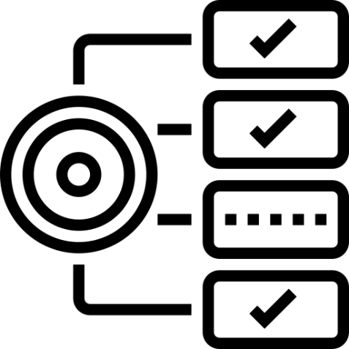




Requirements
Understanding of client business objectives and industry landscape.
Adaptability to address challenges and resistance to change.
Strong communication and collaboration skills.
Ability to analyze and prioritize strategic options.
Access to relevant data and resources for strategy development

Slide 5
Procedure for Business Ideation Strategy
Winning Aspiration
Strategic Clarity: Identify the multiple paths to success within their industry, potentially revealing previously unseen opportunities.
Aspirations can be refined and revised over time
Aspirations shouldn’t change day to day
2. Where to play?
Align & Amplify: Choosing playing fields that align with the client’s aspirations and amplify their impact
Ruthless Prioritization: Obtain the fields where the client doesn’t want to play to eliminate distractions.
Clarity: There should be clarity from Consumers to channels and customers; to competition; to local, regional, and global differences.
Conviction: Identifying what business they really want to get in.
Collaboration: Identifying ways to win in the selected playing field.
3. How to win?
Define the method by which the client will win on the field
How can they create unique value, and how it can sustainably deliver that value to customers in a way that is distinct from its competition.
Match the firm’s advantages (both existing and potential) against its where-to-play choices.
Perform SWOT Analysis

Slide 6
4. What capabilities must be in place?
Identify what must they excel at to thrive in their chosen field and achieve their desired victory.
Strategy-oriented :- Optimal position arrangement that makes the most benefits for the final goals
Position-oriented :- Designed around positions, not people. Comprising of functional positions that contribute to the business aims
Stable and flexible :- Flexible enough to adapt to the internal and external environment changes
Strengthen accountability :- Structure to promote accountability. It should ensure adequate guide and control. Hierarchy should be reasonable and smooth to ensure clear, rapid information flows.
5. What management systems are required?
Robust Management Systems are the backbone of strategy, translating aspiration into actions and measuring progress.
Strategic Agility: A well-defined process for creating, reviewing, and communicating the strategy ensures everyone is aligned and adaptable.
Capability Champions: Dedicated structures nurture and support core capabilities, empowering the organization to excel in its chosen arena.
Performance Pulse: Clear metrics and regular reviews provide insight into the strategy's effectiveness, enabling course corrections when needed.

Slide 7
General Instructions
The Analyst needs to make the MVP for a presentation notes document for the Partner one day before and the final version the night before the presentation that helps him/her navigate the presentation.
Objective Alignment: Ensure all team members understand the client's business objectives, aspirations, and the scope of our consulting engagement to maintain focus.
8

Slide 8
General Challenges
Lack of Publicly Available & Stakeholder Given Information about their Business Operations.
Stakeholder Alignment: Achieving consensus among various stakeholders with differing priorities and perspectives can be challenging.
Resistance to Change: Anticipate and prepare for resistance from the client organization towards recommended changes. Develop strategies to demonstrate value and facilitate buy-in.
Identifying the subniche of the client’s product or service.
Lack of Competitors Information in the identified subniche.
8

Slide 9
Process Implementation Checklist
Do’s | Don’ts
Do keep it simple & focused, 16-20 slides are optimal | Don’t make it too long
Do hook the audience through the narration | Don’t have unstructured schema for the slides
Do use visuals, icons and infographics, bullet points | Don’t add too many texts
Do make the theme of the slides in unison of the client logo | Don’t use bright or bold colors,
8

Slide 10
Inputs

Slide 11
Link to Sample

Slide 12
Revision History
Appendix
Archives

